Slide 1

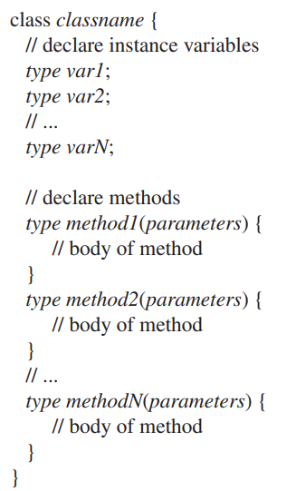
Introducing Classes, Objects, and Methods

Slide 2
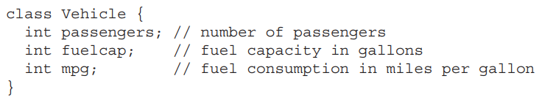

Introducing Classes, Objects, and Methods
Example:

Slide 3
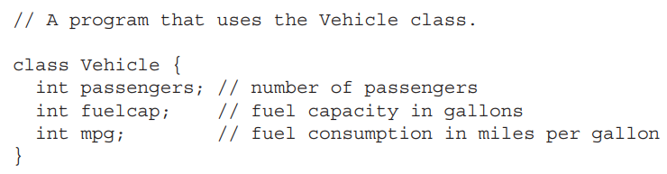
Introducing Classes, Objects, and Methods
Here is a complete example program:

Slide 4
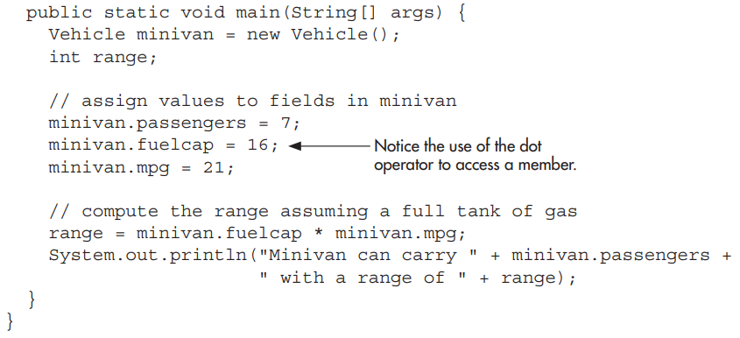
Introducing Classes, Objects, and Methods
Here is a complete example program:

Slide 5

Introducing Classes, Objects, and Methods

Slide 6
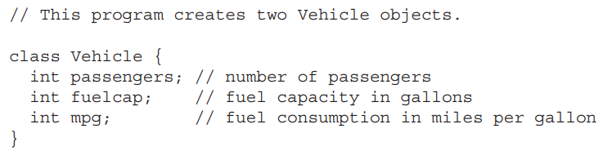
Introducing Classes, Objects, and Methods

Slide 7

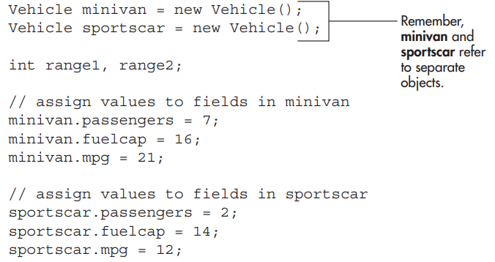
Introducing Classes, Objects, and Methods

Slide 8
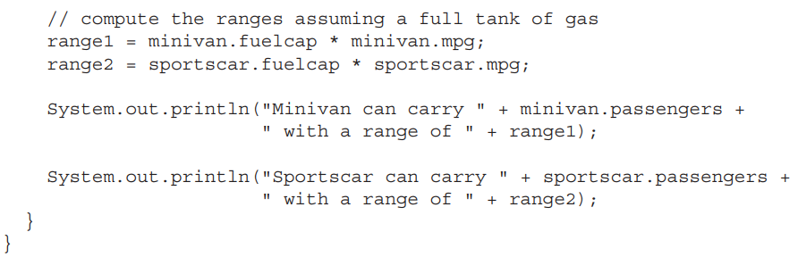
Introducing Classes, Objects, and Methods

Slide 9
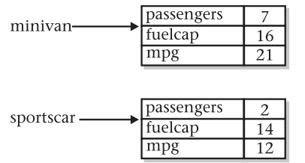
Introducing Classes, Objects, and Methods

Slide 10


Introducing Classes, Objects, and Methods

Slide 11

Introducing Classes, Objects, and Methods
car1 and car2 will both refer to the same object.
This assignment of car1 to car2 simply makes car2 refers to the same object as does car1.
Thus, the object can be acted upon by either car1 or car2. For example, after the assignment

Slide 12
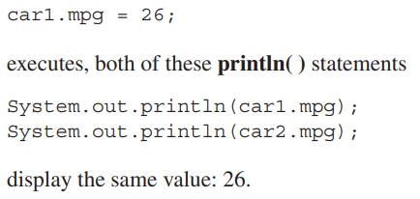
Introducing Classes, Objects, and Methods
For example, after the assignment

Slide 13


Introducing Classes, Objects, and Methods

Slide 14
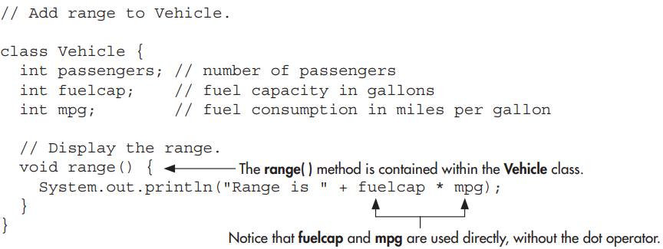
Introducing Classes, Objects, and Methods

Slide 15
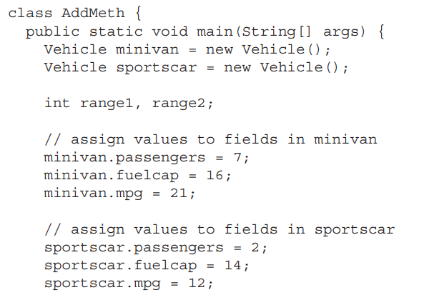
Introducing Classes, Objects, and Methods

Slide 16
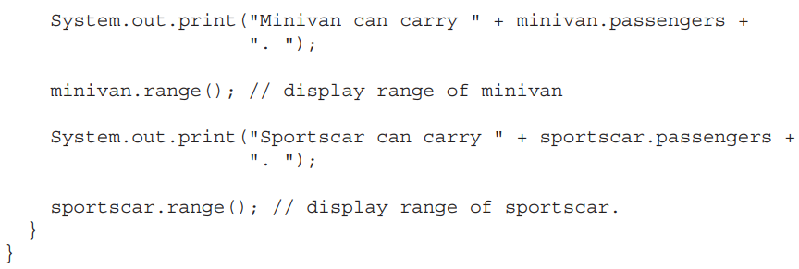
Introducing Classes, Objects, and Methods

Slide 17


Introducing Classes, Objects, and Methods
Home work***

Slide 18

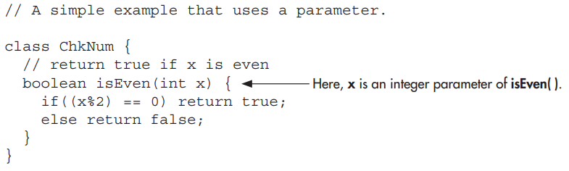
Introducing Classes, Objects, and Methods

Slide 19
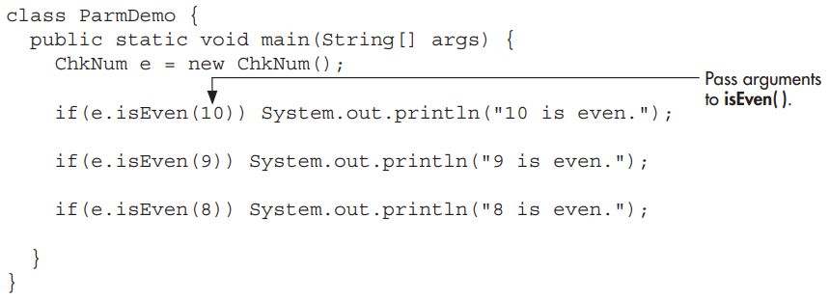
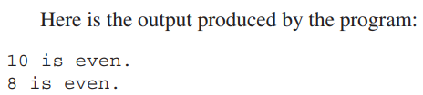
Introducing Classes, Objects, and Methods

Slide 20
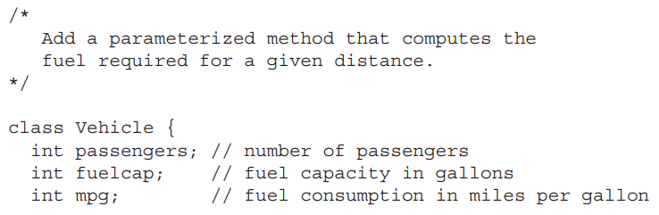
Introducing Classes, Objects, and Methods

Slide 21
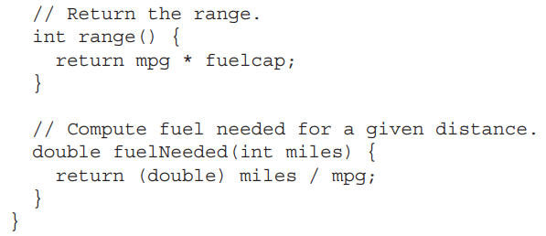
Introducing Classes, Objects, and Methods

Slide 22
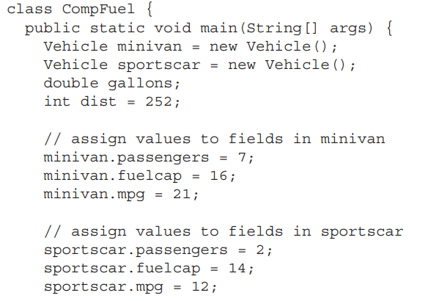
Introducing Classes, Objects, and Methods

Slide 23
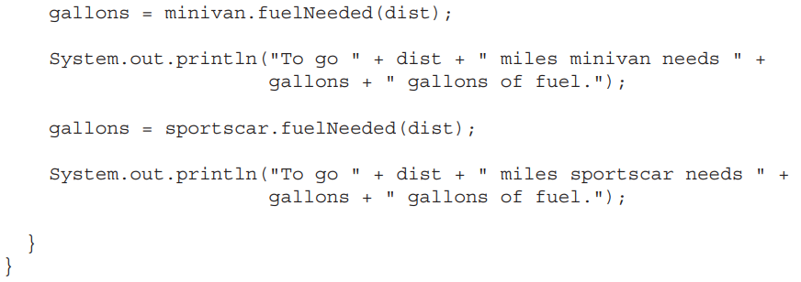
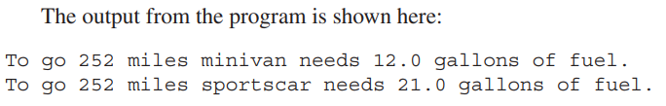
Introducing Classes, Objects, and Methods

